Slide 1
11 Dec 2023
Punjab Engineering College, Chandigarh
SOLUTION TO ECONOMIC LOAD DISPATCH USING LAMBDA ITERATION AND MACHINE LEARNING

Slide 2
Table of Contents
Page
I
Problem Statement
3
II
Solution
4
III
Methodology
5
IV
Case Study
10
V
Conclusion
12
VI
Future Scopes
13

Slide 3
Problem Statement
The power plants in a practical power system have varied fuel costs and are not all situated at the same distance from the center of loads.
Additionally, the generation capacity exceeds the total load demand and losses under normal operating conditions.
Consequently, scheduling generation has a wide range of alternatives. Hence, Economic Load Dispatch comes into role.
For an interconnected power system to function effectively and dependably, sufficient analysis and understanding of its financial management are necessary.
3

Slide 4
Solution
The study of economic load dispatch makes it possible to operate power systems effectively and economically, guaranteeing a steady supply of electricity.
The ELD problem involves minimizing the total generation cost while satisfying a set of equality and inequality constraints related to power balance, generator limits, and transmission network limitations.
ELD problem can be solved via traditional techniques like Lambda-Iterative , Newton-Raphson Method, Gradient method, etc.
In this research paper, we have used Lagrangian Multiplier and Machine Learning Algorithm for ELD problem.
4

Slide 5
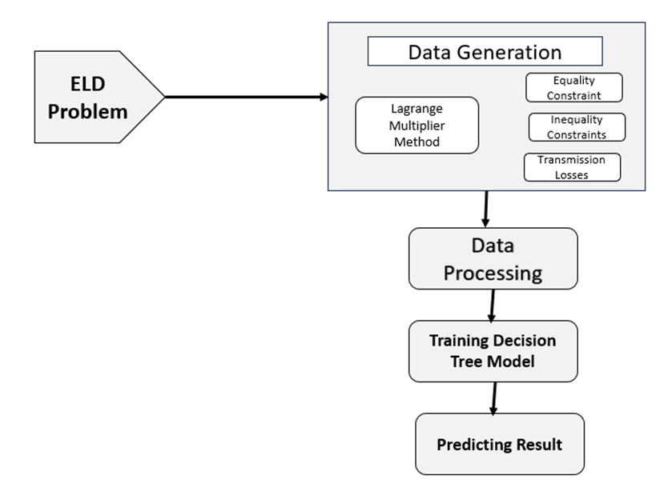
METHODOLOGY
5

Slide 6

Flow of Research Paper
1) Generating Data set using Lambda Iteration considering constraints for 3 and 6 generating units.
2) This approach was used for both 3 generating units and 6 generating units with losses.
3) Training the dataset using Decision Tree Model and Predicting the desired demand power in a range of constrained inputs.
6

Slide 7

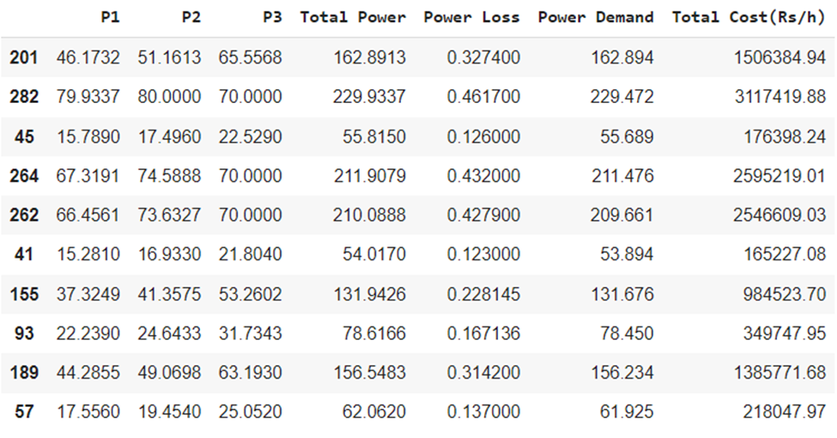

Data Generation
TABLE I. PROCESSED DATA SAMPLE FOR 3 GUs
7

Slide 8
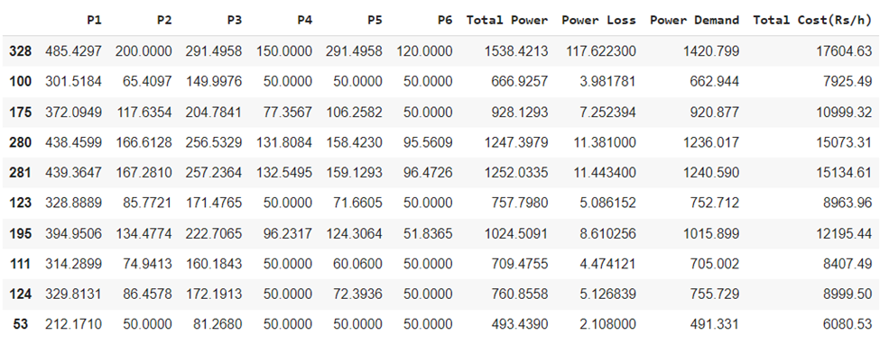
I
Data Generation
TABLE II. PROCESSED DATA SAMPLE FOR 6 GUs
8

Slide 9

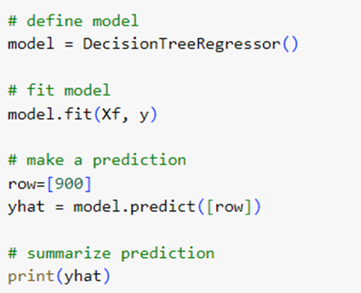
II
Training the Model
The Decision Tree is Trained using the generated data. Then the load sharing between generating units and cost is predicted taking power demand as input.
DT Model from ML code
9

Slide 10

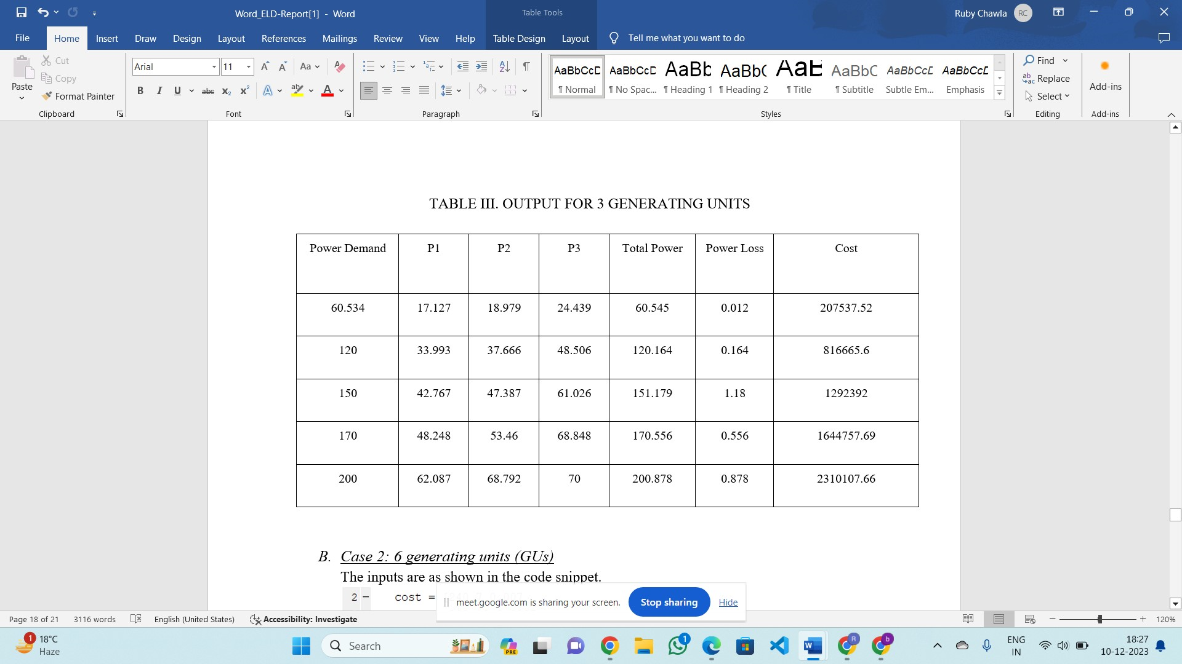
Case Study
10

Slide 11
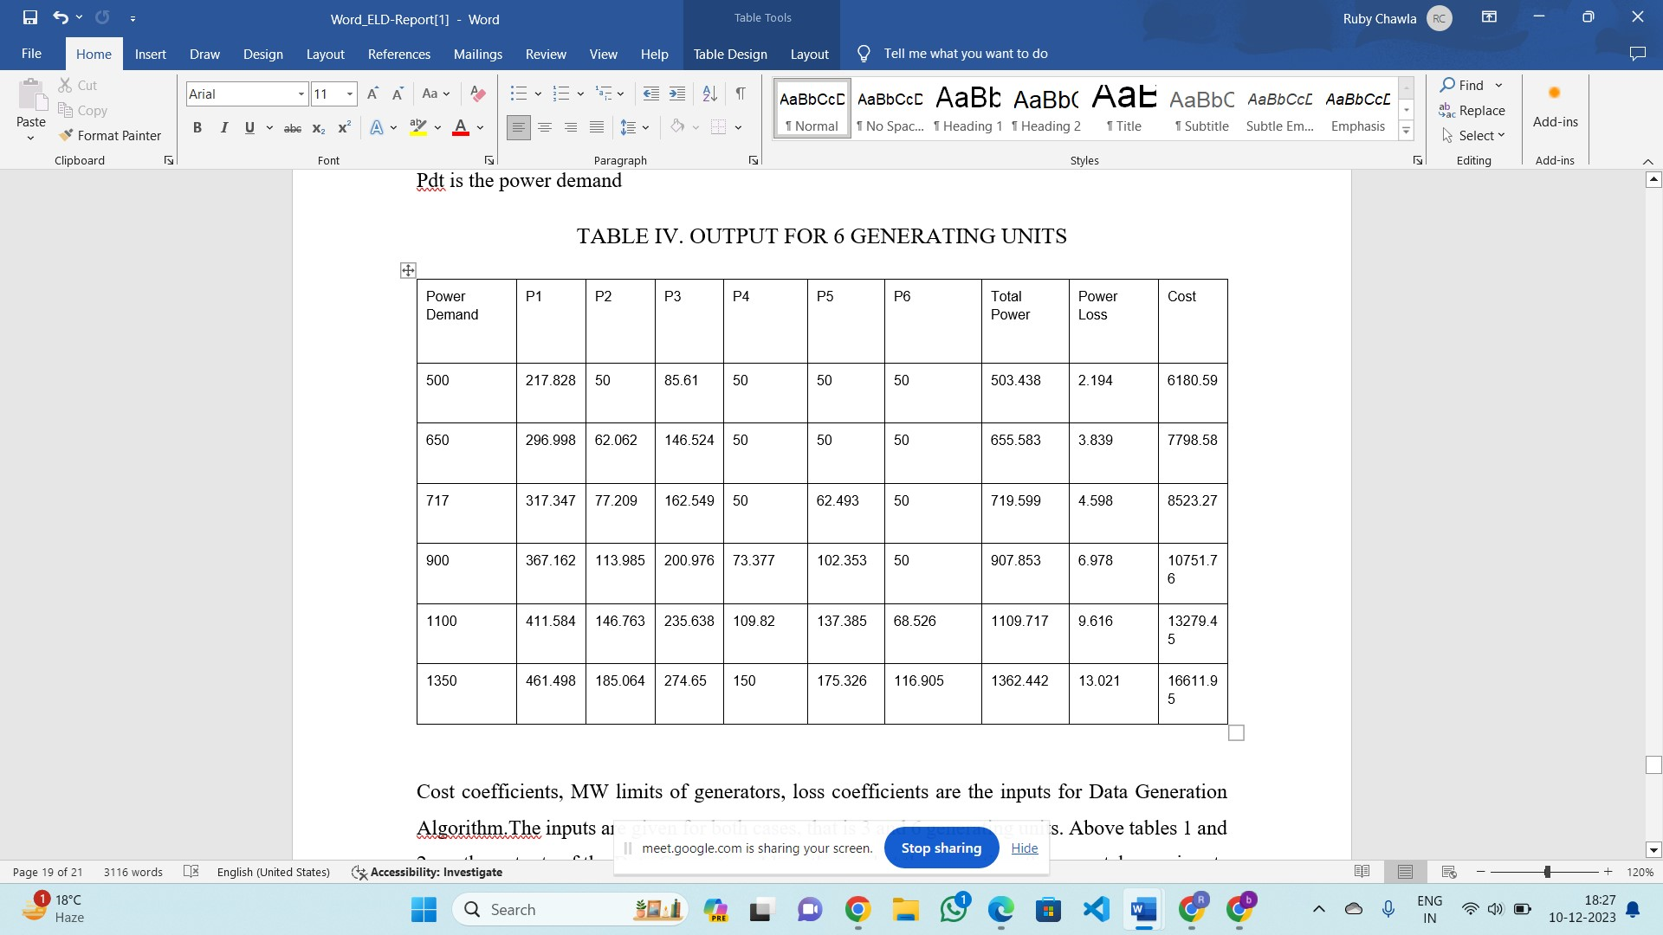
Case Study
little bit ofex
11

Slide 12

Conclusion
In conclusion, this study we have validated with 2 cases that is for 3 and 6 generating units and predicted energy scheduled at each generating units considering inequality, equality and transmission loss constraints using Decision Tree Classifier that was trained by synthetic data generated using Lagrange multiplier Algorithm.
12

Slide 13

Future Scope
1).Further this project can be extended as for n Generating Units.
2).Investigating the integration of advanced AI models, particularly deep learning techniques, could further enhance the accuracy and efficiency of Economic Load Dispatch (ELD) optimization.
3).Future studies could focus on enhancing the existing models to accommodate the integration of renewable energy sources.
13

